Slide 1
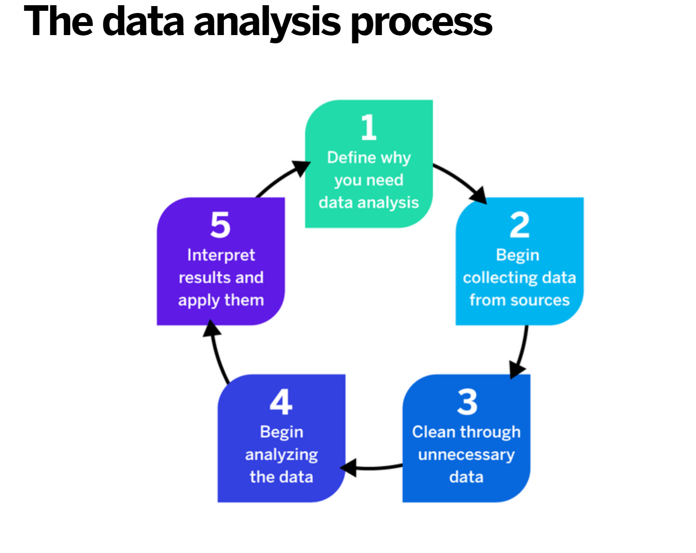
Qualitative Analysis
Let’s analyse data
SHAMINI NADARAJAN-BOARDMAN

Slide 2
Asking Questions when looking at data
What’s going on here?
How can we make sense of these accounts? analytic sensibility
Language used.
Meaning behind the language
Thematic analysis involves an active process of reflexivity, where a researcher’s subjective experience plays a central role in meaning making from data.

Slide 3
4 ways of analyzing results from your interview
1.Thematic analysis, condensing the material in your interview into codes, themes and then superordinate themes.
2.Interpretative phenomenological analysis, where you explore the participant’s lived experience of romantic love (or un-romantic love) by condensing the material in your interview into the ordered themes that capture this lived experience.
3.Discourse analysis, where you examine the language and interpretive repertoires drawn on by the participant in their account of romantic love.
4.Foucauldian discourse analysis, where you identify the shared, taken-for-granted assumptions drawn on by the participant in their account of romantic love, and examine what these understandings imply in terms of subjectivities, expectations of behaviours and the construction of power.

Slide 4
Your stand in Thematic Analysis
If you adopt a thematic analysis, you are taking up a critical realist position, where you are making the assumption that your participant’s language is understood to be an accurate reflection of their thoughts and feelings.
Your research question will be of the general form:
What is the meaning of romantic love for one layperson in contemporary Australia?
As the name implies, a thematic analysis involves finding themes.
A theme:
is a description of a belief, practice, need, or another phenomenon that is discovered from the data
emerges when related findings appear multiple times across participants or data sources

Slide 5
What is Thematic analysis
Thematic analysis is used to analyse qualitative data –
that is, data relating to opinions, thoughts, feelings and other descriptive information.
It’s become increasingly popular in social sciences research, as it allows researchers to look at a data set containing multiple qualitative sources and pull out the broad themes running through the entire data set.
That data might consist of articles, diaries, blog posts, interview transcripts, academic research, web pages, social media and even audio and video files. They are put through data analysis as a group, with researchers seeking to identify patterns running through the corpus as a whole

Slide 6


4 Approaches in Thematic Analysis
Inductive TA
  Generate an analysis from the bottom
  Analysis not shaped by existing theory
Theoretical TA
  Guided by existing theory
Experiential TA
  Focus on the participants’ standpoint – how they experience and make sense of the world
Constructionist TA
  Focuses on how topics are constructed and also how accounts construct the world.

Slide 7
Pros and Cons: Thematic Analysis
Strength | Weakness
Flexibility in terms of theoretical framework, research questions, methods of data collection and sample size. Accessible to researchers with little or no research experience Relatively easy and quick to learn and to do compared to others. Results of TA can be accessible to an educated wider audiences. | Lacking of substance of other ‘branded’ and theoretically driven approaches like IPA & GT Limited interpretative power if not used within an existing theoretical framework; in practice analyses often consist simply of (realist) descriptions of participants’ concerns More interpretative analysis Because it focus on patterns across datasets, it cannot provide any sense of the continuity and contradictions within individual accounts. Can’t make claims about the effects of language used.

Slide 8
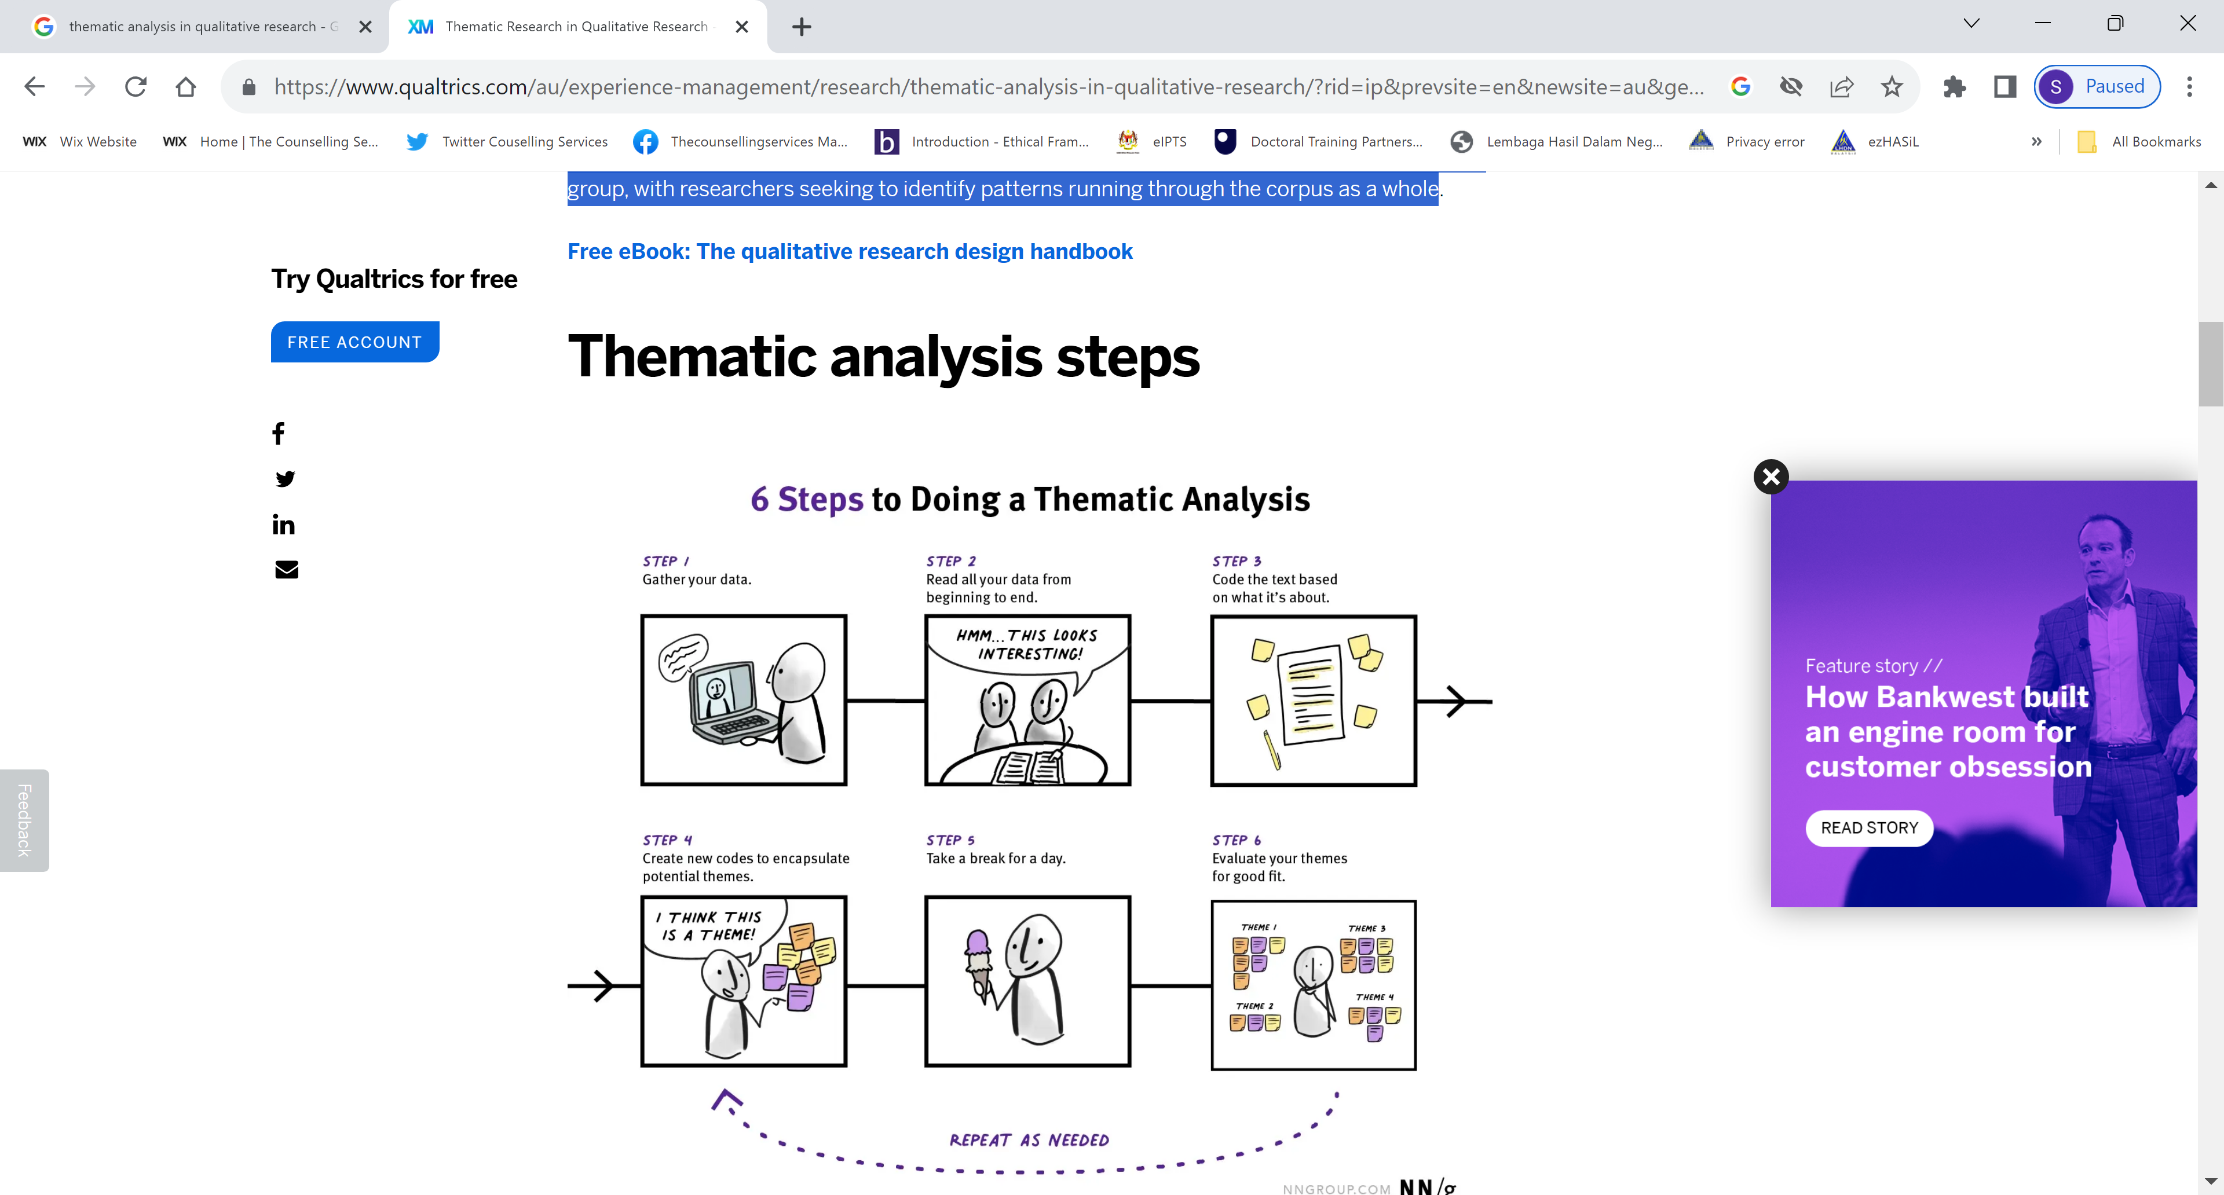

Slide 9
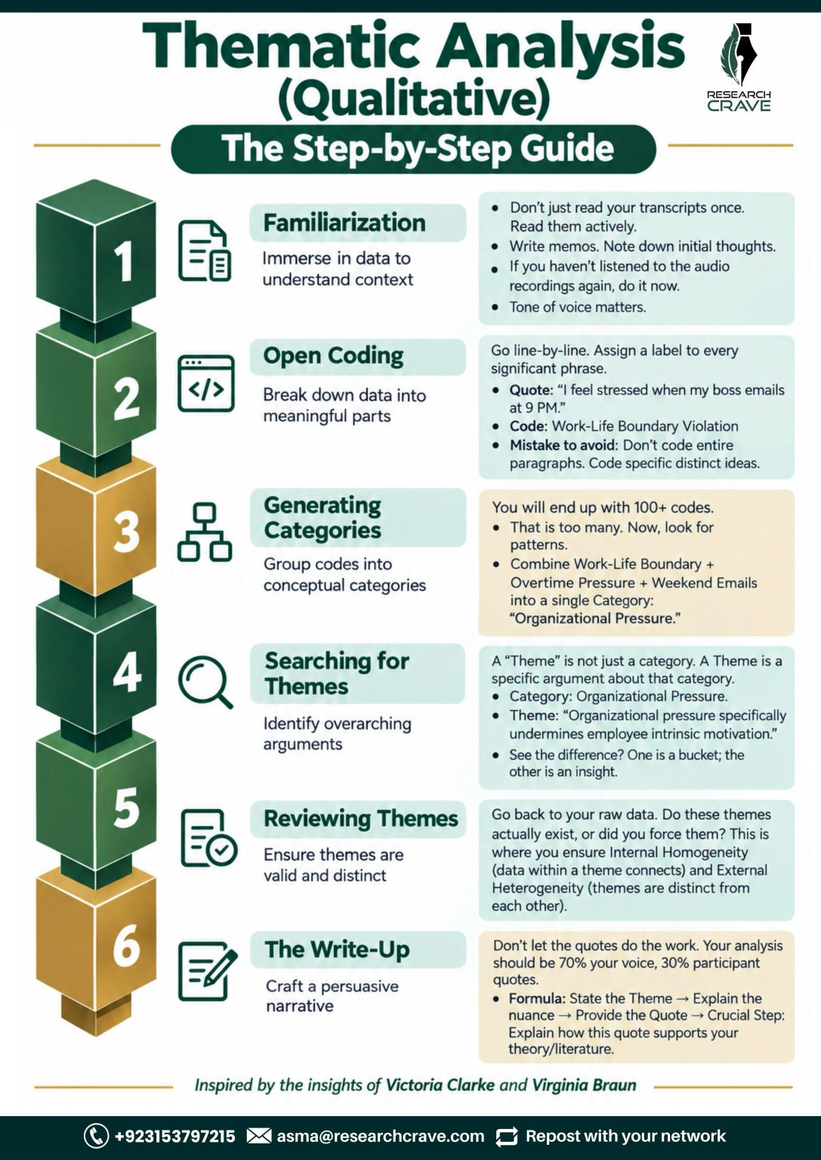




Slide 10
Thematic analysis involves initial analysis, coding data, identifying themes and reporting on the findings.
Braun & Clarke’s (2006) – 6 step framework
1.Familiarisation – During the first stage of thematic analysis, the research teams or researchers become familiar with the dataset. This may involve reading and re-reading, and even transcribing the data. Researchers may note down initial thoughts about the potential themes they perceive in the data, which can be the starting point for assigning initial codes.
2.Coding – Codes in thematic analysis are the method researchers use to identify the ideas and topics in their data and refer to them quickly and easily. Codes can be assigned to snippets of text data or clips from videos and audio files. Depending on the type of thematic analysis used, this can be done with a systematic and rigorous approach, or in a more intuitive manner.
3.Identifying theme – Themes are the overarching ideas and subject areas within the corpus of research data. Researchers can identify themes by collating together the results of the coding process, generating themes that tie together the identified codes into groups according to their meaning or subject matter.

Slide 11
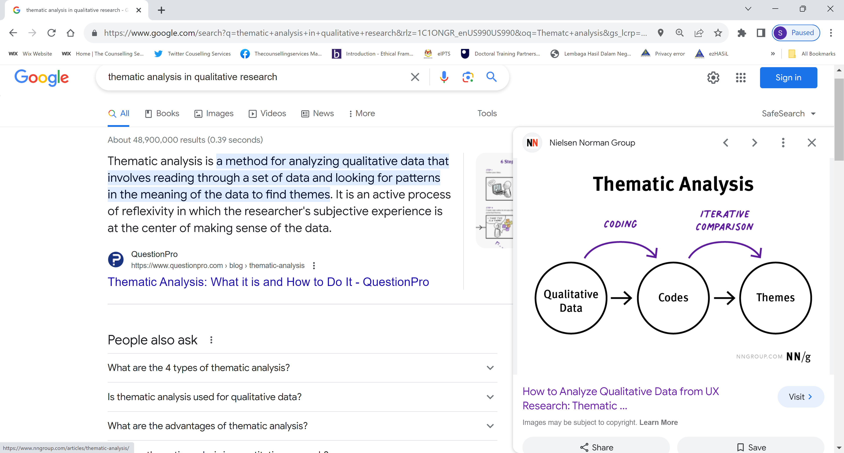

Slide 12
Thematic analysis involves initial analysis, coding data, identifying themes and reporting on the findings.
4.Reviewing themes – Once the themes have been defined, the researchers check back to see how well the themes support the coded data extracts. At this stage they may start to organise the themes into a map, or early theoretical framework.
5.Defining and naming themes – As researchers spend more time reviewing the themes, they begin to define them more precisely, giving them names. Themes are different from codes, because they capture patterns in the data rather than just topics, and they relate directly to the research question.
6.Writing up – At this stage, researchers begin to develop the final report, which offers a comprehensive summary of the codes and themes, extracts from the original data that illustrate the findings, and any other data relevant to the analysis. The final report may include a literature review citing other previous research and the observations that helped frame the research question. It can also suggest areas for future research the themes support, and which have come to light during the research process.
https://speakai.co/the-best-free-thematic-analysis-tools/
https://www.maxqda.com/thematic-analysis-software#!

Slide 13
Braun and Clarke’s framework
Braun and Clarke’s (2006) framework and apply it in a systematic manner to describe and explain the process of analysis within the context of learning and teaching research.
Illustrate the process using a worked example based on (with permission) a short extract from a focus group interview, conducted with undergraduate students.
Braun & Clarke (2006) distinguish between two levels of themes: semantic and latent.
Semantic themes ‘…within the explicit or surface meanings of the data and the analyst is not looking for anything beyond what a participant has said or what has been written.’ analysis moves beyond describing what is said to ocus on interpreting and explaining it.
Latent level looks beyond what has been said and ‘…starts to identify or examine the underlying ideas, assumptions, and conceptualisations – and ideologies - that are theorised as shaping or informing the semantic content of the data’

Slide 14
Braun and Clarke’s framework
Braun & Clarke (2006) distinguish between a
Top-down or Theoretical thematic analysis,that is driven by the specific research question(s) and/or the analyst’s focus, and
Bottom-up or inductive one that is more driven by the data itself.

Slide 15
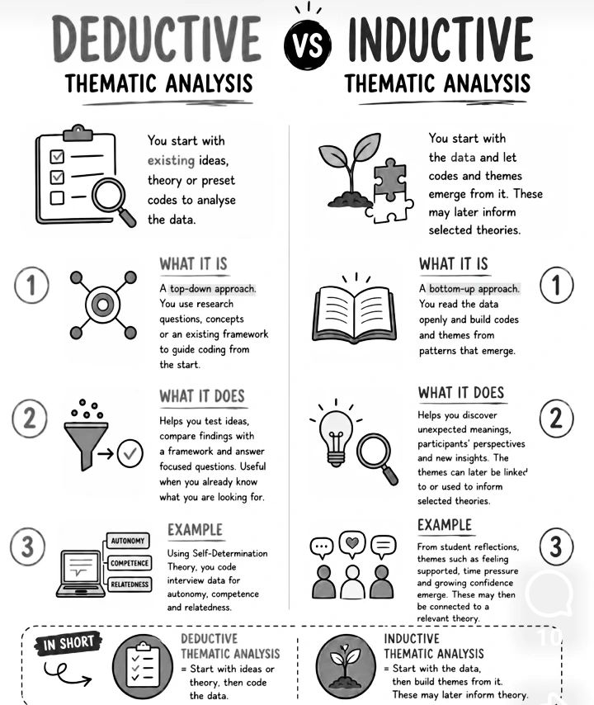
HYBRID

Slide 16
Step 1: Become familiar with the data.
The more you engage with the data, the more they ‘open up’ to you.
The students do seem to think that feedback is important but don’t always find it useful. There’s a sense that the whole assessment process, including feedback, can be seen as threatening and is not always understood. The students are very clear that they want very specific feedback that tells them how to improve in a personalised way. They want to be able to discuss their work on a one-to-one basis with lecturers, as this is more personal and also private. The emotional impact of feedback is important.
Read , and re-read the transcripts.
Be familiar with your entire body of data or data corpus (i.e. all the interviews and any other data you may be using) before you go any further.
Make notes and jot down early impressions. Below are some early, rough notes made on the extract:

Slide 17











Different coding styles
COMPLETE CODING
Instead of looking for particular instances, you aim to identify anything and everything of interest or relevance to answering your research question, within your entire dataset.
This means that rather than selecting out a particular corpus of instances which you then analyse, you code all the data that’s relevant to your research question, and it’s only later in the analytic process that you become more selective. In complete coding, codes identify and provide a label for a feature of the data that is potentially relevant for answering your research question
DATA-DERIVED AND RESEARCHER-DERIVED CODES
provide a succinct summary of the explicit content of the data; they are semantic codes, because they are based in the semantic meaning in the data. When coding participant-generated data, they mirror participants’ language and concepts
SELECTIVE CODING -involves identifying a corpus of ‘instances’ of the phenomenon that you’re interested in, and then selecting those out. The purpose here is one of ‘data reduction’.. This approach to coding is often seen as a pre-analytic process, the pragmatic selection of your data corpus, rather than as part of your analysis (e.g. Potter & Wetherell, 1987).
Narrative discourse

Slide 18
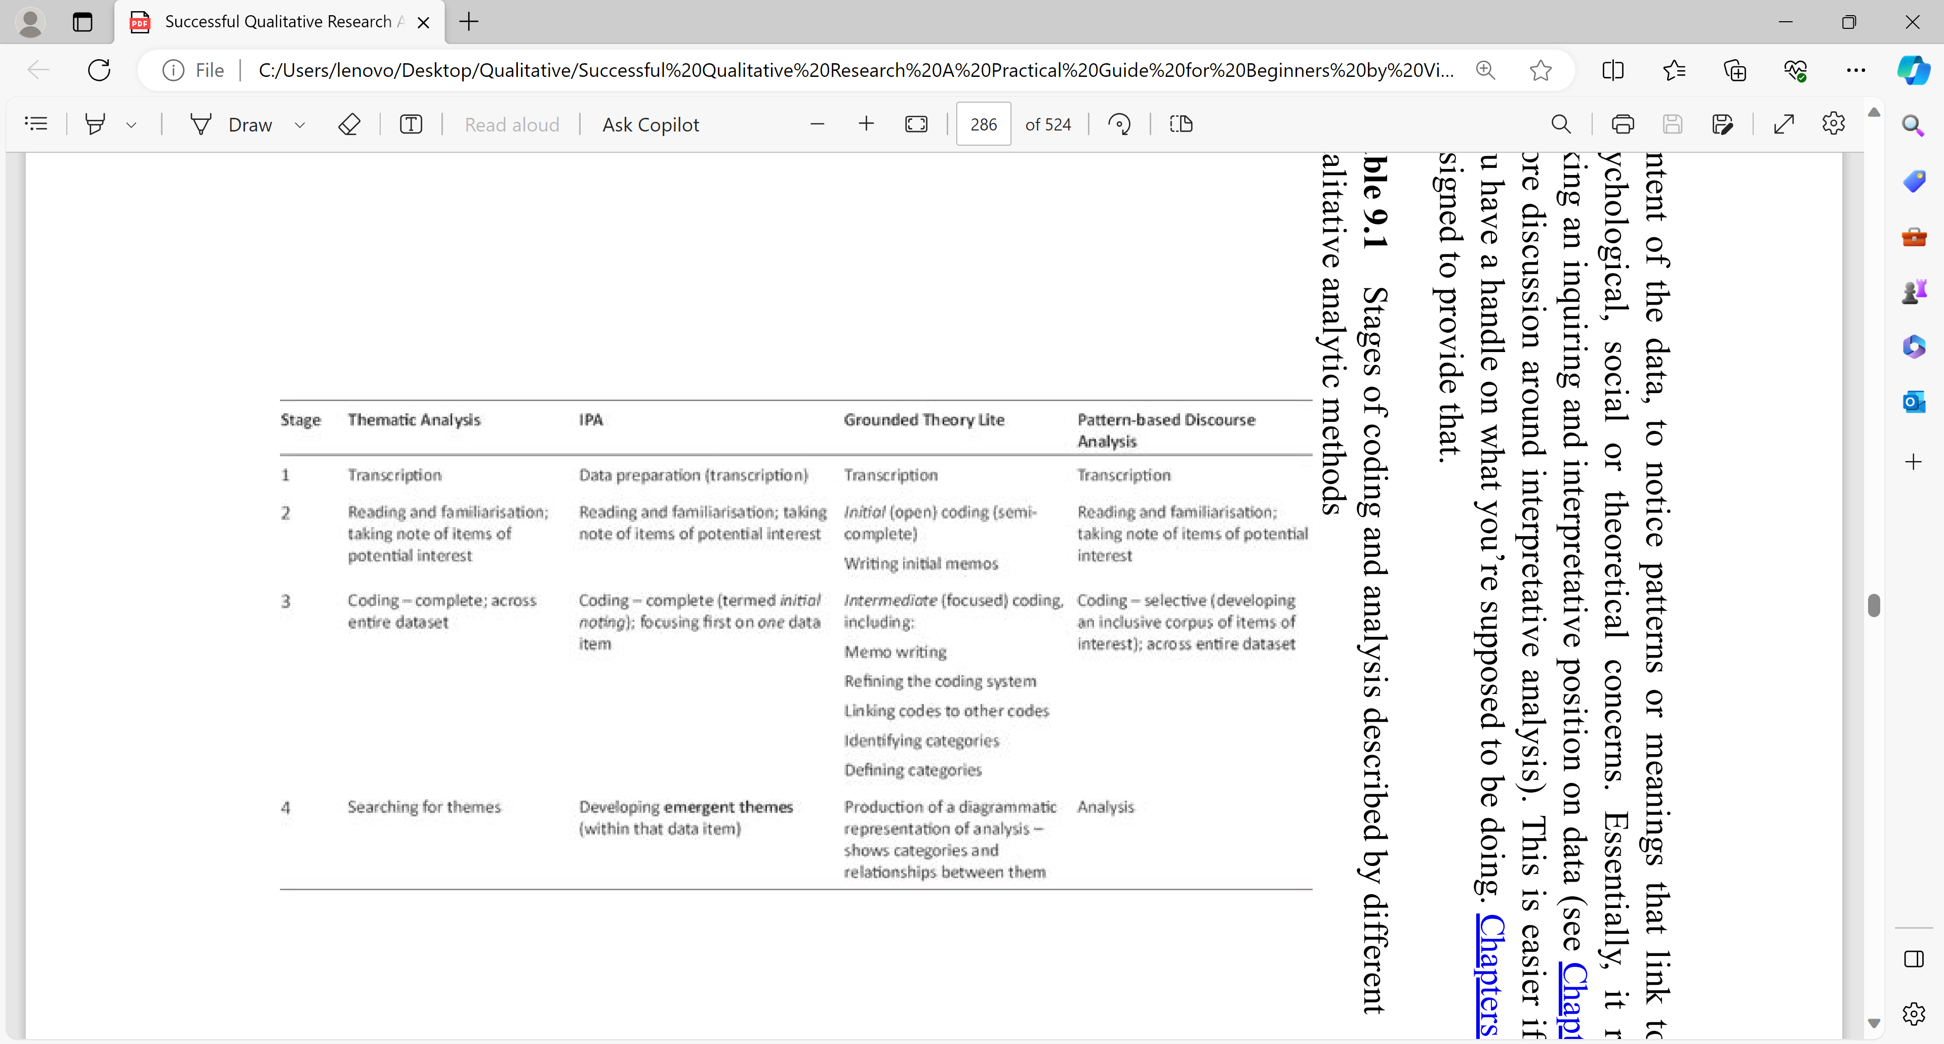



Slide 19
Deductive- codes predetermined from Research questions
Inductive -forming codes that comes from data
Hybrid – both methods
In approaches like TA they may become the initial blocks in the process of coding then building your final analysis. In IPA, in contrast, the focus is on capturing and interpreting the participants’ experiences, it is recommended that you note down your ideas and observations and then put them aside (basically forget them for a while), so that your analytic eye remains focused on the participants’ meanings and experiences

Slide 20
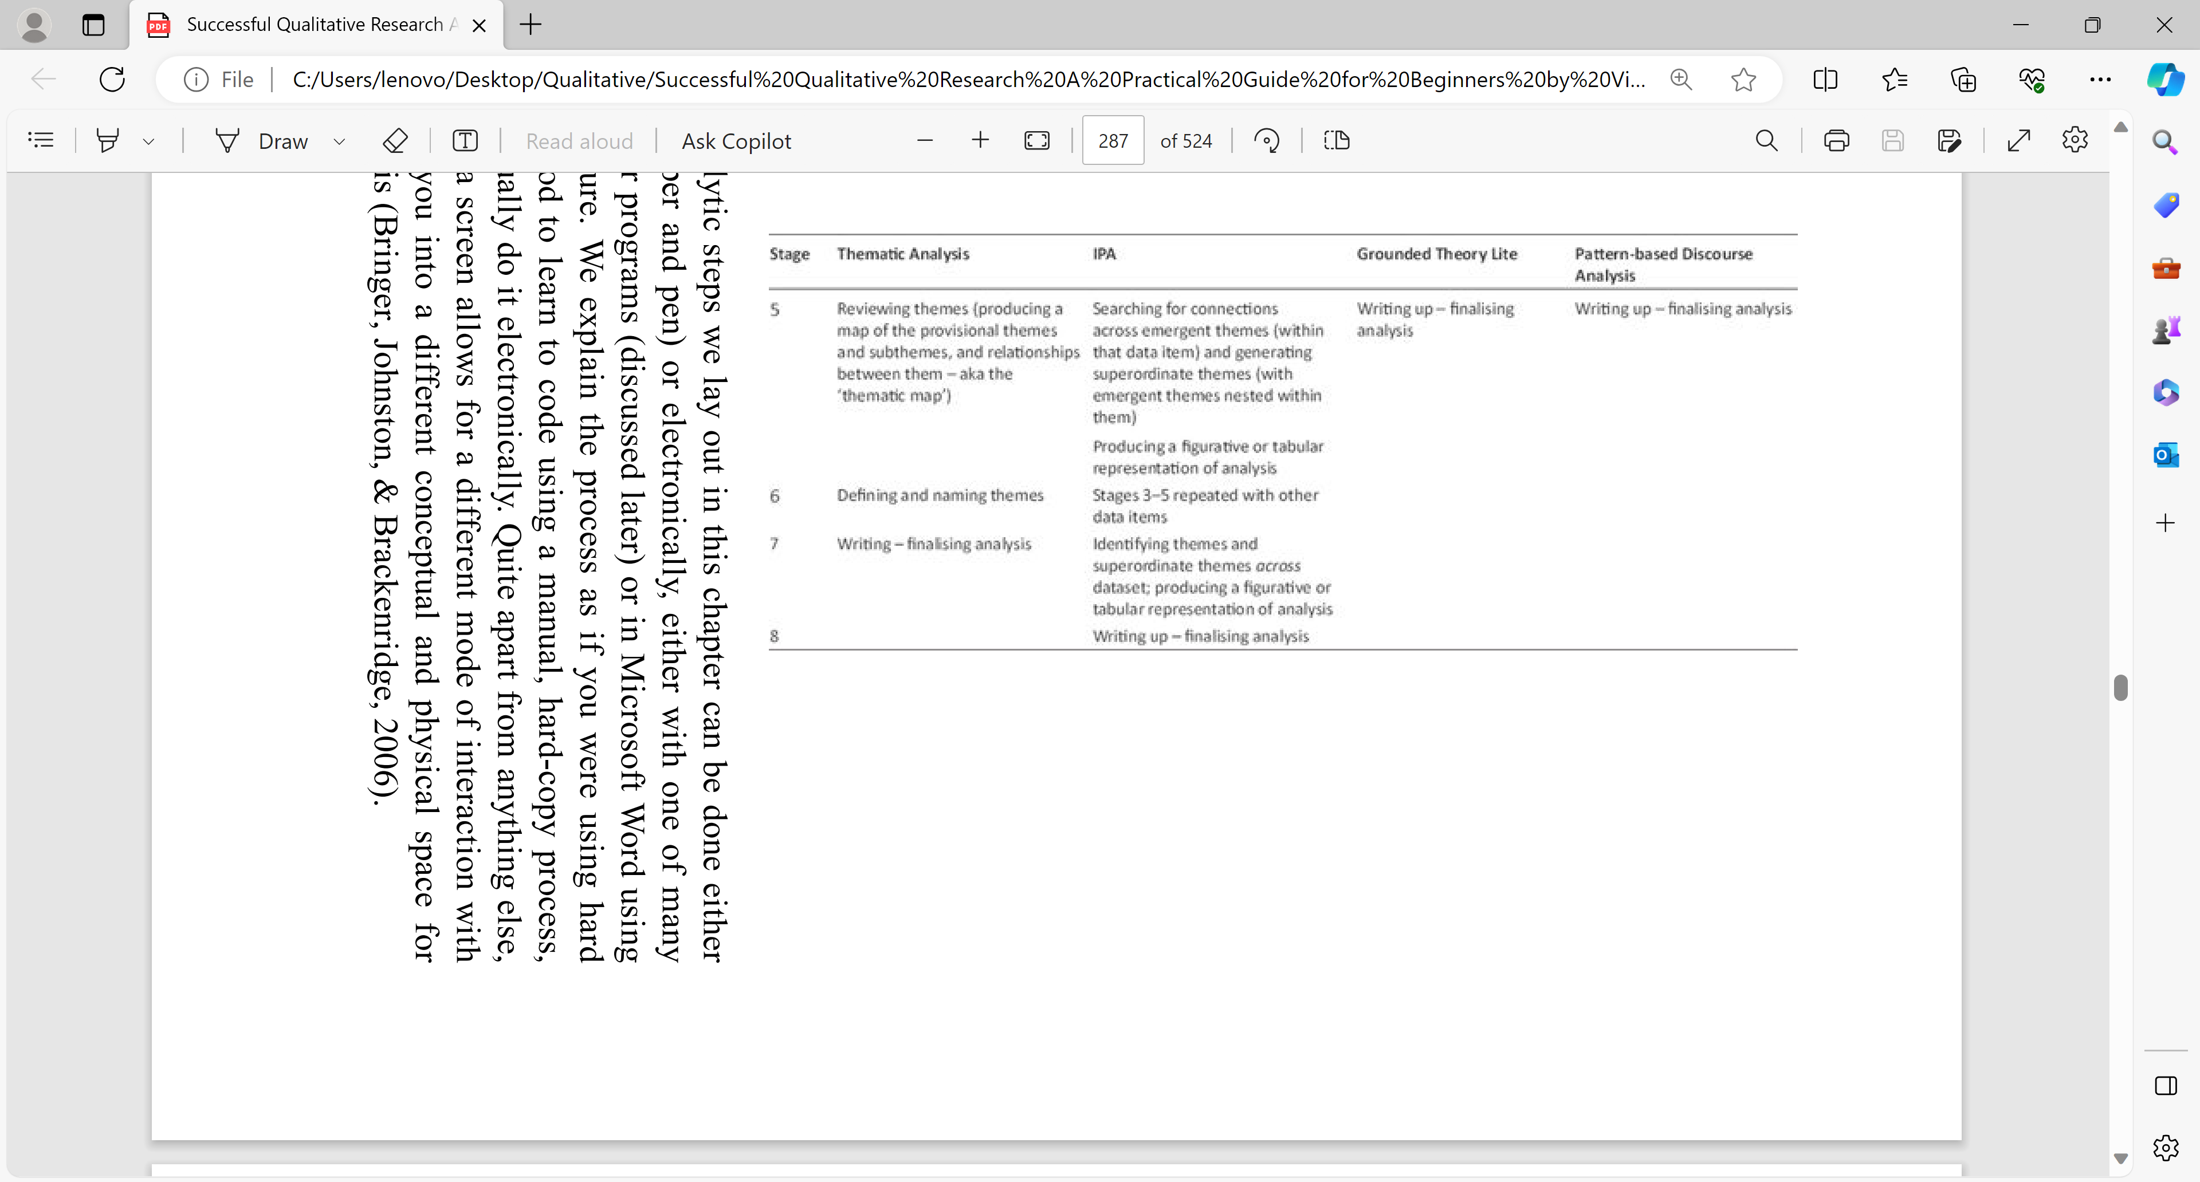

Slide 21
Step 2 CTD : Generate initial codes
7. Discuss these and develop some preliminary ideas about codes
8. Then code transcript separately. Work through each transcript coding every segment of text that seemed to be relevant to or specifically address your research question.
10 Compare your codes, discuss them and modify them before moving on to the rest of the transcripts.
11.As you work through them, generate new codes and sometimes modify existing ones. Do this by hand initially, working through hardcopies of hardcopies of the transcripts with pens and highlighters.
12. Qualitative data analytic software (e.g. ATLAS, Nvivo etc.), if you have access to it, can be very useful, particularly with large data sets. Other tools can be effective also; for example, Bree & Gallagher (2016) explain how to use Microsoft Excel to code and help identify themes.

Slide 22
Step 2: Generate initial codes
1. Organise our data in a meaningful and systematic way. Coding reduces lots of data into small chunks of meaning.
2. There are different ways to code and the method will be determined by your perspective and research questions.
3. If you are concerned with addressing specific research questions and analyse the data with this in mind – so it will be a theoretical thematic analysis rather than an inductive one. (if Inductive analysis -line-by-line coding to code every single line.)
4. Code each segment of data that is relevant to or captured something interesting about your research question. Don’t have to code every piece of text.
5. Use open coding; that means you don’t have pre-set codes, but developed and modified the codes as we worked through the coding process.
6. Notice things that keep coming up in all your transcripts.

Slide 23
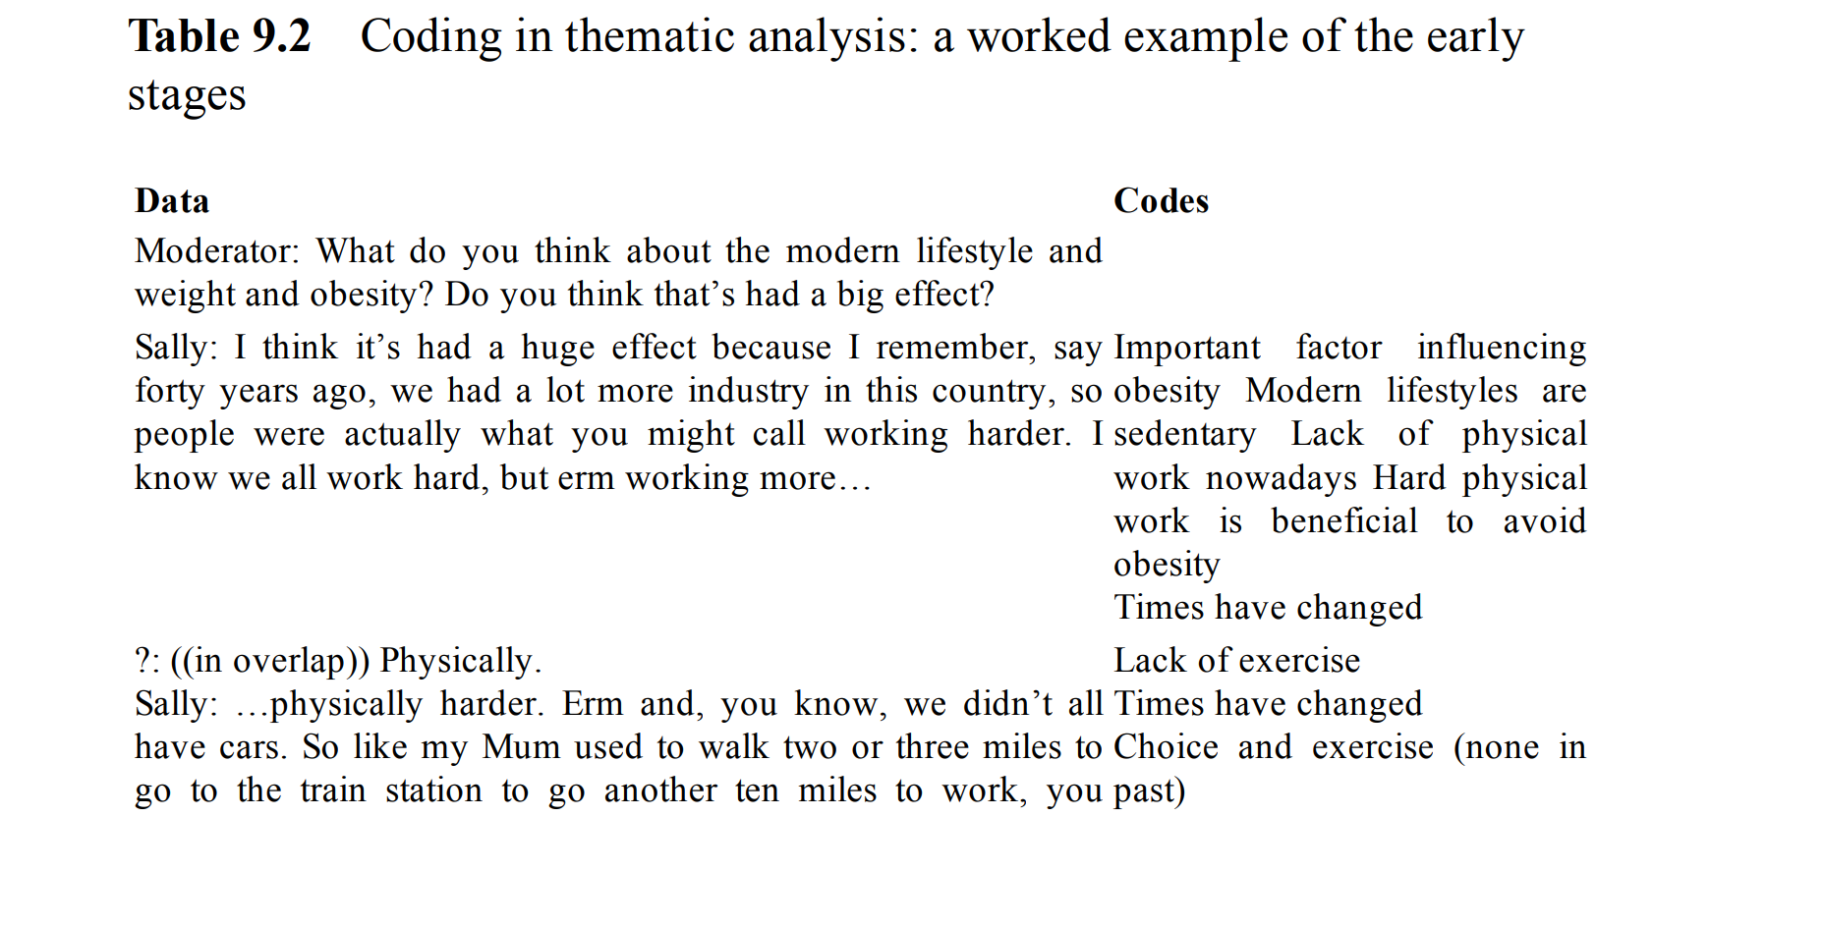










Slide 24
DOING COMPLETE CODING
1. Begin with your first data item, and systematically work through the whole item, looking for chunks of data that potentially address your research question. You can code in large chunks (e.g. 20 lines of data), small chunks (e.g. a single line of data), and anything in between, as needed.
2 Data that don’t contain anything relevant to the research question don’t need to be coded at all.
3. If you are starting with a very broad research question, which you may refine during the analytic process, you want to code widely and comprehensively; if you already have a very specific research question, you may find that large sections of the data are not relevant and don’t need to be coded
4 Basically, every time you identify something potentially relevant, code it.
5 Coding on hard-copy data, clearly writing down the code name, and marking the text associated

Slide 25
Step 3: Search for themes.
A theme is a pattern that captures something significant or interesting about the data and/or research question.
No hard and fast rules about what makes a theme. A theme is characterised by its significance.
Examine the codes and and check if some of them clearly fitted together into a theme.
For example, if you have several codes that related to perceptions ,thoughts or feelings about something , you can collate them into an initial theme .
At the end of this step the codes should be organised into broader themes that will seem to say something specific about your research question.
Your themes can predominately be descriptive,i.e. they described patterns in the data relevant to the research question.

Slide 26
Step 3: Search for themes from Coding
In the next slide the preliminary themes that are identified in Extract 1, along with the codes that are associated with them.
Most codes are associated with one theme although some, are associated with more than one (these are highlighted in Table 2).
In this example, all of the codes fit into one or more themes but this is not always the case and you might use a ‘miscellaneous’ theme to manage these codes at this point.

Slide 27
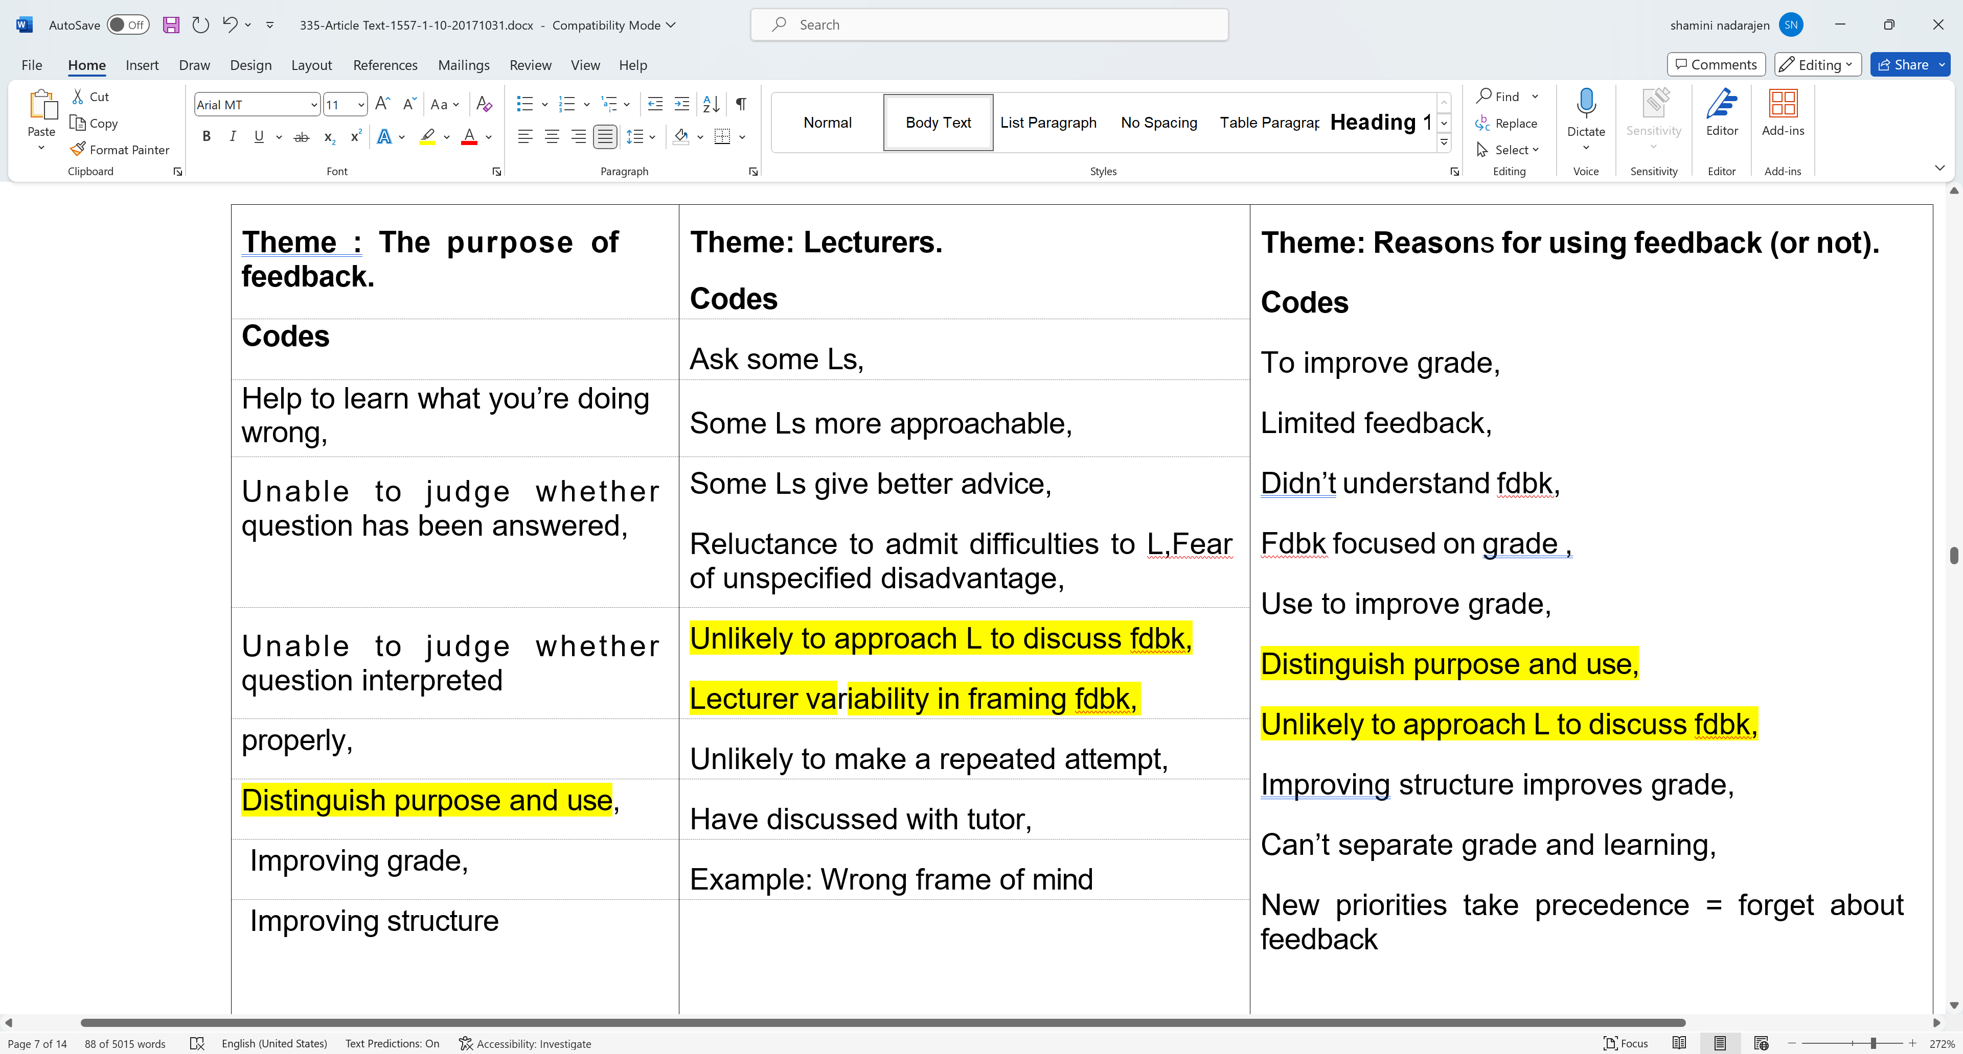




Slide 28
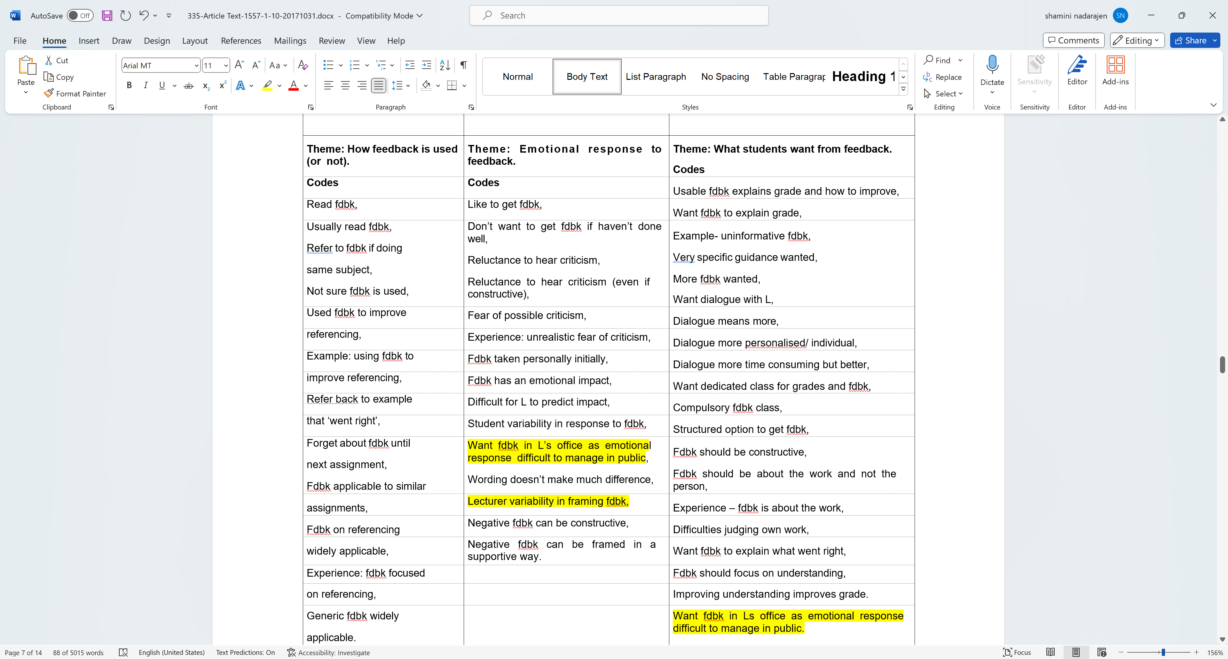

Slide 29
Step 4: Review themes.
1. Review, modify and develop the preliminary themes that you identified in Step 3. Do they make sense?
2. Gather together all the data that is relevant to each theme. You can easily do this using the ‘cut and paste’ function in any word processing package, by taking a scissors to your transcripts or using something like Microsoft Excel (see Bree & Gallagher, 2016).
3. Access to qualitative data analysis software can make this process much quicker and easier, but it is not essential.. The data associated with each theme is colour-coded.
4. You read the data associated with each theme and considered whether the data really did support it.
5. The next step is to think about whether the themes work in the context of the entire data set…..

Slide 30
Step 4 Ctd: Review themes.
Themes should be coherent and they should be distinct from each other. Things to think about include:
    Do the themes make sense?
    Does the data support the themes?
    Am I trying to fit too much into a theme?
    If themes overlap, are they really separate themes?
    Are there themes within themes (subthemes)?
    Are there other themes within the data?

Slide 31
Step 4 ctd: Review themes.
For example, we felt that the preliminary theme, Purpose of Feedback ,did not really work as a theme in this example. There is not much data to support it and it overlaps with Reasons for using feedback(or not) considerably. Some of the codes included here (‘Unable to judge whether question has been answered/interpreted properly’) seem to relate to a separate issue of student understanding of academic expectations and assessment criteria.
We felt that the Lecturers theme did not really work. This related to perceptions of lecturers and interactions with them and we felt that it captured an aspect of the academic environment. We created a new theme Academic Environment that had two subthemes: Understanding

Slide 32
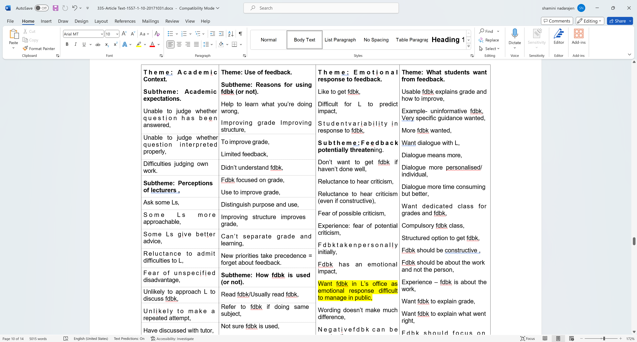

Slide 33
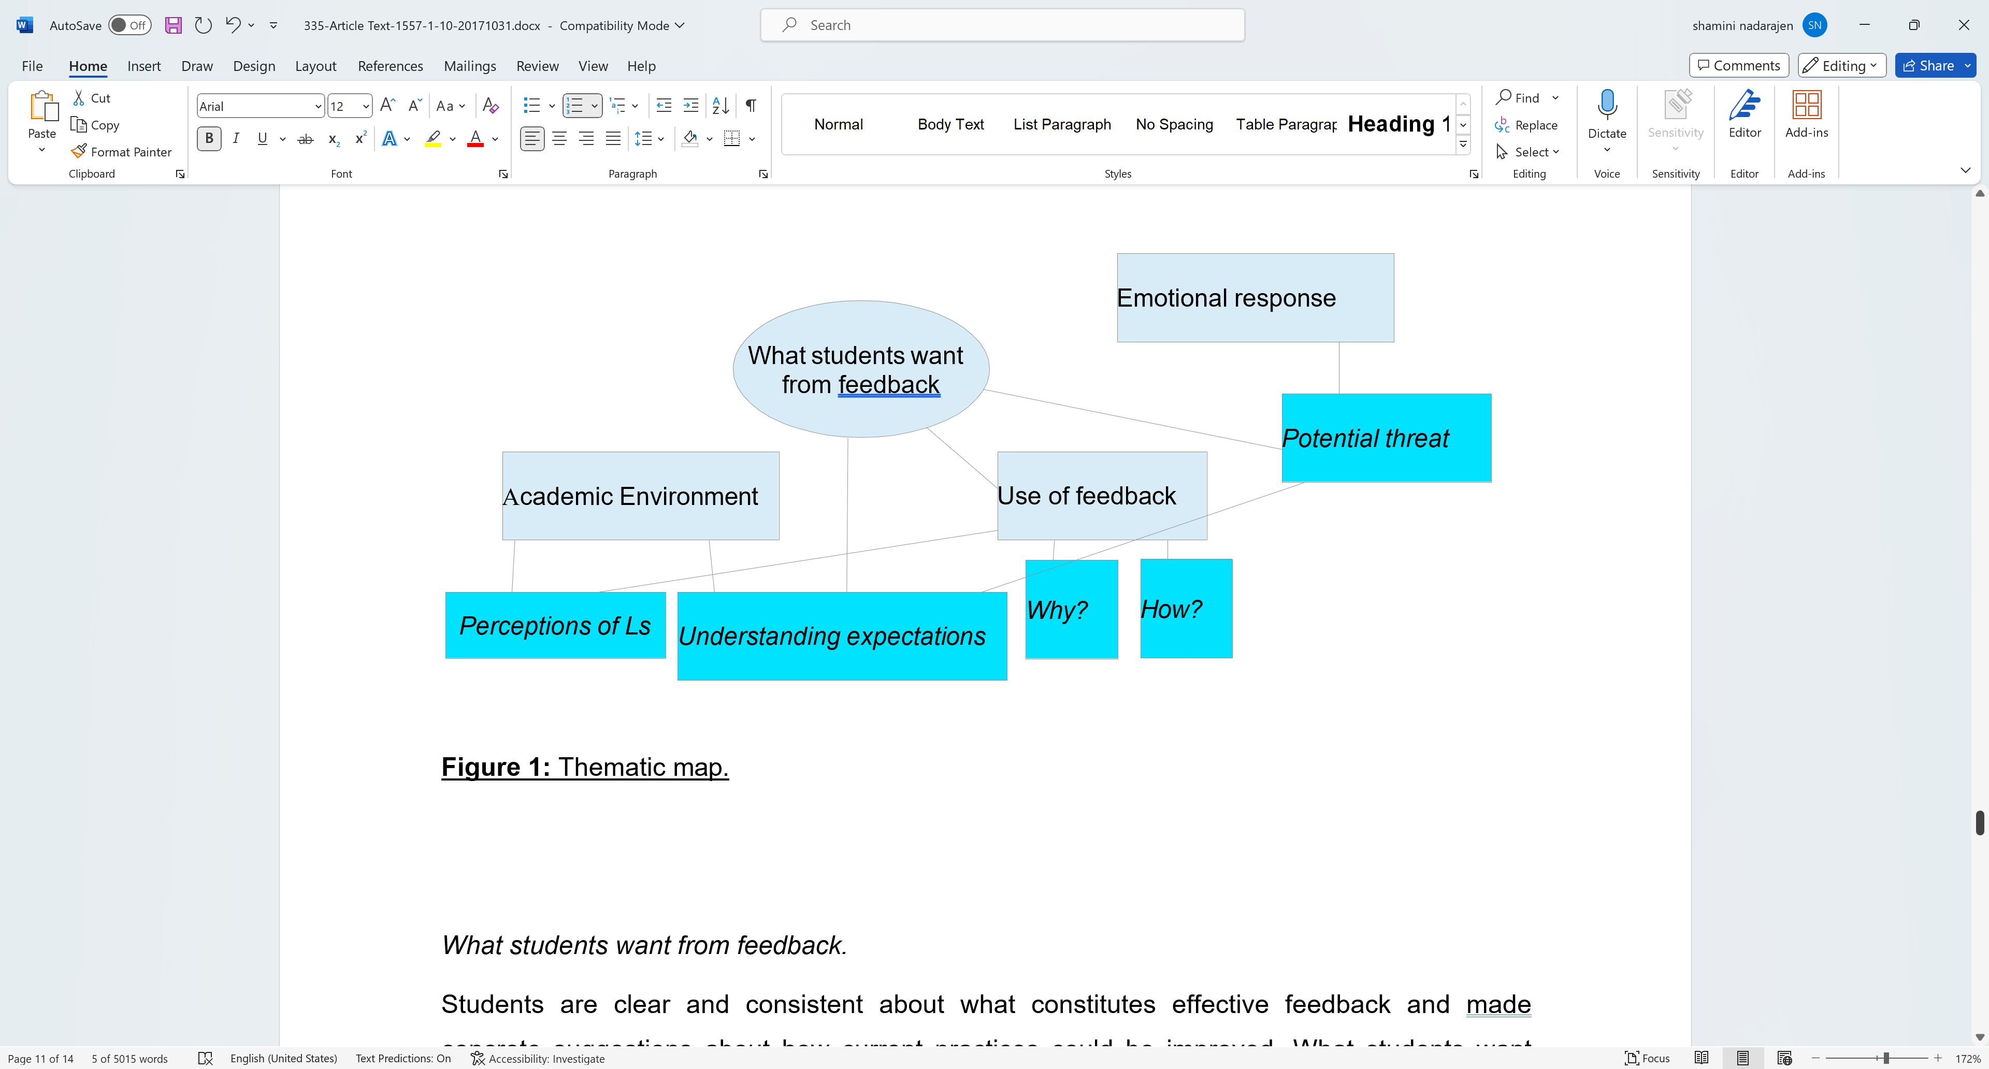
  Step 5: Define themes
This is the final refinement of the themes, and the aim is to ‘..identify the ‘essence’ of what each theme is about.’.(Braun & Clarke, 2006, p.92).
What is the theme saying?
If there are subthemes, how do they interact and relate to the main theme?
How do the themes relate to each other?
.

Slide 34
An example
Research Title: Exploring Experiences of Online Learning During the COVID-19 Pandemic
Research Question: How do undergraduate students perceive and experience online learning during the COVID-19 pandemic?
Data Source: Semi-structured Interviews with Undergraduate Students
Thematic Coding Analysis:Coding Sheet

Slide 35
Coding
Code | Description | Example(s)
Schedule Flexibility | References to the flexibility of online class schedules | "I appreciate being able to watch lectures at any time."
Technological Challenges | Mention of technical difficulties or barriers to accessing online materials | "Poor internet connection often disrupts my learning experience."
Social Isolation | Statements about feeling isolated or disconnected from peers and instructors | "I miss the face-to-face interactions with my classmates."
Motivation and Engagement | Comments on motivation levels and engagement with online coursework | "It's harder to stay motivated when I'm studying alone at home."
Academic Support | References to the availability and effectiveness of academic support services | "The online tutoring sessions have been really helpful."

Slide 36
Themes
Schedule Flexibility
  Description: Participants appreciated the flexibility of online learning, allowing them to manage their time more effectively and accommodate other commitments.
  Example Quotes:
    "I appreciate being able to watch lectures at any time. It's convenient for me to fit studying around my job."
    "Online classes give me the freedom to study at my own pace and prioritize my assignments."
Technological Challenges
  Description: Participants encountered various technological challenges, such as poor internet connection and difficulty accessing online materials, which impacted their learning experience.
  Example Quotes:
    "My internet connection is not always reliable, so I often struggle to participate in live lectures."
    "I find it frustrating when I can't access course materials due to technical issues. It disrupts my study routine."

Slide 37
Themes
3 Social Isolation
  Description: Participants expressed feelings of social isolation and loneliness due to the lack of face-to-face interaction with peers and instructors.
  Example Quotes:
    "I miss the face-to-face interactions with my classmates. It's hard to stay motivated when I'm studying alone at home."
    "I feel disconnected from my professors and classmates. It's not the same as being in a physical classroom."

Slide 38
Themes
4 Motivation and Engagement
  Description: Participants reported varying levels of motivation and engagement with online coursework, with some finding it challenging to stay motivated without the structure of traditional classroom settings.
  Example Quotes:
    "It's harder to stay motivated when I'm studying alone at home. I miss the energy of being in a classroom with other students."
    "I find it easier to focus and stay engaged during live lectures. Online classes feel more passive, and I struggle to stay attentive."

Slide 39
Themes
5 Academic Support
  Description: Participants valued the availability and effectiveness of academic support services, such as online tutoring sessions, which helped them navigate challenges and succeed in their coursework.
  Example Quotes:
    "The online tutoring sessions have been really helpful. I appreciate having access to additional support when I need it."
    "I've reached out to my professors for help via email, and they've been responsive and supportive. It's reassuring to know that help is available when I need it."

Slide 40
Step 6: Writing-up Themes
                See examples on Mytimes
                We will continue this in Tutorials
                RTA OR TA (next slide)

Slide 41
RTA or TA ? ( this will go into Appendix or Chapter 3/4/5)
The reflexive approach to TA highlights the researcher’s active role in knowledge production (Braun and Clarke 2019).
Codes are understood to represent the researcher’s interpretations of patterns of meaning across the dataset
Reflexive thematic analysis (RTA) is considered a reflection of the researcher’s interpretive analysis of the data conducted at the intersection of:
(1) the dataset;
(2) the theoretical assumptions of the analysis, and;
(3) the analytical skills/resources of the researcher (Braun and Clarke 2019).
It is fully appreciated—even expected—that no two researchers will intersect this tripartite of criteria in the same way. As such, there should be no expectation that codes or themes interpreted by one researcher may be reproduced by another (although, this is of course possible)
https://link.springer.com/article/10.1007/s11135-021-01182-y#Sec3

Slide 42
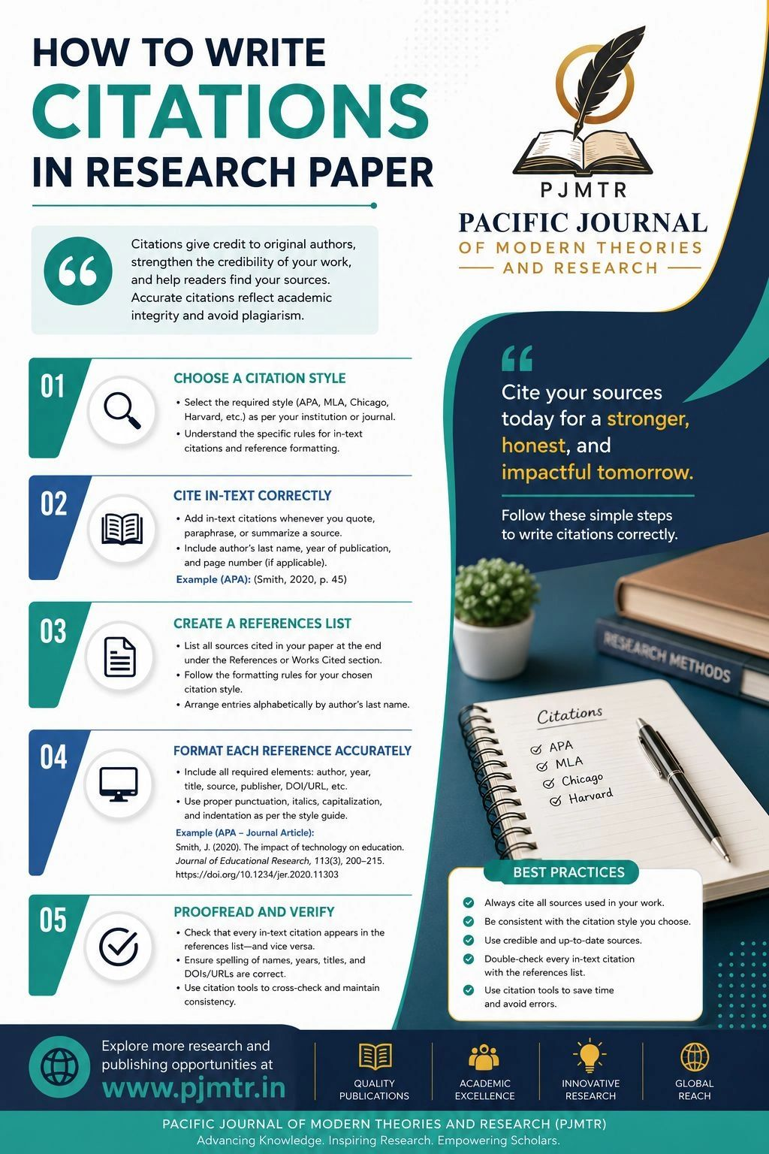
SUBMIT YOUR REFERENCES APPENDIX BUT NO ETHICAL FORMS WITH CHAPTER 3

